Slide 1
Analysis and implementation of Efficient Audio Watermarking.
Under the esteemed Guidance of:
Mr.Rajesh Rohilla
(ASSOCIATE PROFESSOR)
DEPARTMENT OF ELECTRONICS AND COMMUNICATION
SUBMITTED BY:
MUKESH SAHU
COLLEGE ROLL NO: 16/E&C/08
UNIVERSITY ROLL NO. 10052

Slide 2
Digital Watermarking
Technique which allows an individual to add hidden copyright notices or other verification messages to digital media
Message is a group of bits describing information pertaining to the signal or its author
Embedding of unobtrusive (unnoticeable) marks or labels that can be represented in bits in digital content
Embedded marks are generally invisible (or imperceptible) but can be detected or extracted

Slide 3
Other Terms
Steganography
Art and science of writing hidden messages
No one apart from the intended recipient knows of the existence of the message
Cryptography
Message itself is not disguised, but the content is obscured
Study of message secrecy

Slide 4
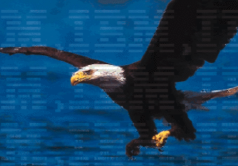
Types Of Watermarks
Visible
Signal changed completely
Watermarked signal different from original

Slide 5
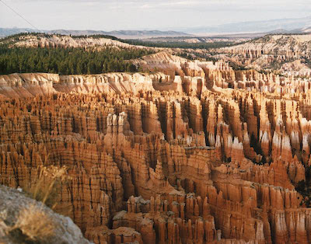
Types Of Watermarks
Invisible
Signal not changed to a large extent
Minor variations to output signal

Slide 6
Watermark Categories
Robust Watermark
Sticks to document its embedded in
Removing it destroys quality of signal
Used for copyright protection
Fragile Watermark
Breaks very easily on modifying host signal
Used for tamper detection and digital signature
Semi Fragile Watermark
Sensitive to signal modification
Gives information about nature and location of attack
Provides data authentication

Slide 7
Classification Of Watermarks

Slide 8
A Digital Watermarking System
Unlike encryption, which is useful for transmission but does not provide a way to examine the original data in its protected form, the watermark remains in the content in its original form and does not prevent a user from listening to, viewing, examining, or manipulating the content.

Slide 9
Terminology
Cover-signal
the audio-visual signal (still image, audio track, video) in which one wish to hide information
Watermark
what is actually imperceptibly added to the cover-signal in order to convey the hidden data
Watermarked signal
Cover signal + watermark
Payload
message or sequence of information bits to be hidden in the cover-signal, that is the hidden data
Watermarking-scheme
the set algorithms required for embedding and extraction
Embedding-key
a secret key used to embed the mark
Extraction-key
a key used to detect or extract a watermark

Slide 10
Audio Watermarking Techniques
Digital watermarking is the process of attaching the identity of a copyright owner to a digital audio work that is difficult to remove.
There are many challenges to audio watermarking. The technical requirements are that the watermark does not add distortion, be audible in the signal, be robust against further audio processing, be not removable by attacks designed to separate the watermarking from the audio illegally and it must also be easily identifiable by a decoding mechanism.

Slide 11
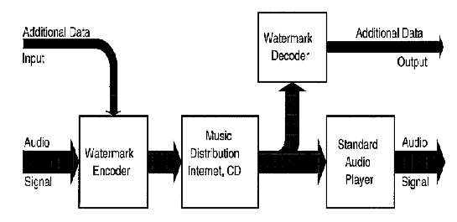
Overview of an audio watermarking system (Neubauer and Herre, 1998)

Slide 12
Requirements of Audio Watermarking
Inaudible
Survives Additional Audio Processing
Survives Bitstream and Post processing Audio Editing
Support for Multiple Applications
Bound to the Original Digital Audio
Easily Extracted by Detection Algorithm
Destroys Artistic work upon attack

Slide 13
Watermarking Detection
There are two ways that a pirate can defeat a watermarking scheme. The first is to manipulate the audio signal to make all watermarks undetectable by any recovery mechanism. The second is to create a situation where the watermarking detection algorithm generates a false result that is equal to the probability of a true result (Boney, et al., 1996).

Slide 14
What Watermarking Should Not Be
There are certain watermarking techniques that should not be used. For example, any watermarking that always places the data into one frequency bin should not be utilized. The reason for this is, as a pirate, it is very easy for one to design a low pass filter, a high pass filter or a band reject filter that simply removes the watermark. Also, it is apparent that this sort of watermark automatically degrades the original audio signal.
Another poor technique is to place the watermark in moments of time where it does not matter that it is audible (so much). For example, in-between songs on a CD or in a place in the audio where the quality of the original work is so poor that the watermarked audio quality is as bad as the song. Again, this is an unacceptable technique. Simple audio editing tools could easily remove the watermark.

Slide 15
Audio Watermarking Techniques
Watermarking in the Time Domain
Watermarking in the Frequency Domain
Watermarking in the Compressed Domain

Slide 16
Watermarking in the Time Domain
Changing the Least Significant Bits of Each Sample
Pyschoacoustic Models to Perform Clear text Marking
Echo Data Hiding

Slide 17
Changing the Least Significant Bits of Each Sample

Slide 18
Pyschoacoustic Models to Perform Clear text Marking
Many watermarking techniques use psychoacoustic modeling to properly place the watermark. Often the watermark itself is represented by a shift keying technique, such as amplitude-shift keying or frequency-shift keying (Lathi, 1983). Usually the sinusoidally represented data is placed where the masking property of psychoacoustic models can be utilized.

Slide 19
Echo Data Hiding
Echo data hiding is the idea of placing data very close, i.e. within microseconds, of the original signal in the time domain. (Bender, et al., 1996) Echo data hiding uses three parameters, initial amplitude, decay rate and offset. Figure illustrates the elements of the technique. The delay plus offset is set at 1/1000 second. This equates to 1ms, which is below the lowest known delay of two signals the human ear can hear as separate. Then the delta is an additional time that is also below perceived signal separation. Thus both a zero and a one will not be perceived with the original signal. This is assuming that the amplitude of the added data is below the amplitude of the original signal.

Slide 20
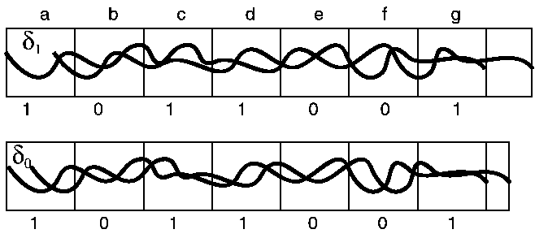
Figure: echo data hiding

Slide 21
Watermarking in the Frequency Domain
Phase Coding
Spread Spectrum

Slide 22
Phase Coding
Phase Coding can be an exceptional coding method. When the phase differential between the original signal and the modified one is kept small, it maintains close to the original un-watermarked audio's signal to perceived noise ratio (Bender, et al, 1996).
The idea behind phase coding is to hide the data by exchanging the original phase of the signal with the phase of the binary watermark plus the differential of the original audio phase. In a way, it is differential coding plus an binary phase offset. The reason for this is a randomly generated binary stream is a square wave. A square wave always possesses a phase of or .

Slide 23
Spread Spectrum
Spread spectrum is the technique of spreading data over the frequency spectrum of the original signal. There are two types of categories for spread spectrum, frequency hopping and direct sequence. Both types of spread spectrum require that the transmitter and receiver are synchronized. Frequency hopping is basically moving about the spectra in a pseudo random pattern. The frequency spectra is divided into bands and then the signal to be hidden is moved from one band to another in rapid succession. Direction sequence, is the multiplication of the original audio signal by a binary sequence in the encoder.

Slide 24
Watermarking in the Compressed Domain
Compressed domain watermarking means manipulation of the bitstream. This implies that one does not change the original bitstream syntax. The example given by (Lacy, et al., 1998) is to apply a data envelope to an MPEG-2 Advanced Audio Coding (AAC) bitstream. There are other techniques to hide data in the bitstream and also MIDI data hiding techniques. The main point is to make decoding the bitstream dependent on the watermark existing in it.

Slide 25
FUNDAMENTAL THEORY OF PROPOSED ALGORITHM

Slide 26
mp3 – MPEG Layer-3 format is the most popular format for downloading and storing music. By eliminating portions of the audio file that are essentially inaudible, mp3 files are compressed to roughly one-tenth the size of an equivalent PCM file while maintaining good audio quality.
wma – the popular Windows Media Audio format owned by Microsoft. Designed with Digital Rights Management (DRM) abilities for copy protection.
atrac (.wav) – the older style Sony ATRAC format. It always has a .wav file extension. To open these files simply install the ATRAC3 drivers.

Slide 27
Synchronization Code (Barkers Code)
Synchronization is one of the key issues of audio watermarking and losing synchronization cause false detection. Time scale and frequency scale modification can cause lost of synchronization. So there is need of an exact synchronization algorithm based on robust synchronization code.
Several reasons which contribute to false synchronization code are: a) The style of synchronization code, b) the length of synchronization code, b) the probability of “0” and “1” in synchronization code.

Slide 28
Barkers codes embedded in the proposed scheme as synchronization code satisfy above mentioned criteria to prevent false synchronization. A Barker code is a sequence of N values of +1 and −1, aj for j= 1, 2, 3 . . ., N.
such that:
for all

Slide 29
The table below shows all known Barker codes; it is conjectured that no other perfect binary phase codes exist.
The +ve and -ve amplitudes of the pulses forming the Barker codes imply the use of biphase modulation; that is, the change of phase in the carrier wave is 180 degrees.
Known Barker Codes
Length | Codes
2 | +1 −1 | +1 +1
3 | +1 +1 −1
4 | +1 +1 −1 +1 | +1 +1 +1 −1
5 | +1 +1 +1 −1 +1
7 | +1 +1 +1 −1 −1 +1 −1
11 | +1 +1 +1 −1 −1 −1 +1 −1 −1 +1 −1
13 | +1 +1 +1 +1 +1 −1 −1 +1 +1 −1 +1 −1 +1

Slide 30
Energy Efficient Watermark
As Jonathan el al[12] proposed that for a robust watermarking scheme, watermark should satisfy the Power Spectrum Condition, which state that power spectrum of watermark should be directly proportional to power spectrum of the original signal. In order to generate energy-efficient (PSC-compliant) watermarks, first, we evaluate the power spectrum
of X of original audio signal x [1, ] by using periodogram,
Where is 2-D FFT of x [n1, n2].

Slide 31
Then we produce energy efficient watermark by
Where is 2-D FFT of the output of a unit variance white Gaussian random number generator.

Slide 32
QUANTIZATION INDEX MODULATION
It firstly embedded information by modulating an index or an index sequence with the watermark bits, and then quantized the host signal with an associated quantizer. Dithering was proposed at the same time to improve the performance and reduce the perceptual distortion in it. The conventional QIM used a fixed quantization step size

Slide 33
The simplest case of QIM is embedding one bit in a single host sample. Let m ϵ {0, 1 } be a 1-bit watermark message, s ϵ R be a host sample, scalar uniform quantizer Q with step size □ is rounding a value. Hence the watermarked signal is generated by
Where . or is an offset used for embedding bit "0" or "1" respectively. These two quantizers form two lattices

Slide 34
SPREAD SPECTRUM WATERMARKING PROCEDURE (Cox algorithm)
Inserting the Watermark
The general procedure for frequency domain watermarking. Upon applying a frequency transformation to the data, a perceptual mask is computed that highlights perceptually significant regions in the spectrum that can support the watermark without affecting perceptual fidelity. The watermark signal is then inserted into these regions

Slide 35
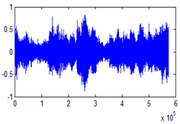
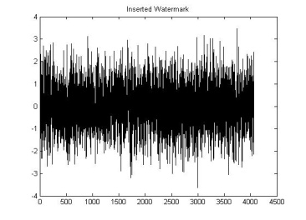
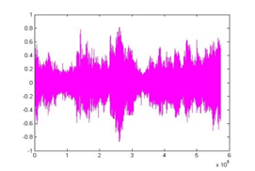
Cover Audio
FFT/DCT
Determine Perceptually Significant Regions
Inverse FFT/DCT
Insert Watermark
Watermarked Audio

Slide 36
When we insert X into V to obtain V’ we specify a scaling parameter α, which determines the extent to which X alters V. Three natural formulae for computing V’ are

Slide 37
Extracting the Watermark
The procedure for extraction and decoding of the watermark is shown in figure 4.3. We extract from each image or document D a sequence of values V = V1, …, Vn; into which we insert a watermark X = x1, …, xn, to obtain an adjusted sequence of values V’ = v1’ …… vn’. V’ is then inserted back into the document in place of V to obtain a watermarked document D’. One or more attackers may then alter D’, producing a new document D*. Given D and D*, a possibly corrupted watermark X* is extracted and is compared to X for statistical significance.

Slide 38
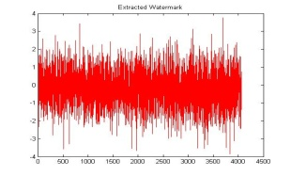
Cover Audio
FFT/DCT
FFT/DCT
Extracted Watermark(X*)
Original Watermark(X)
Similar?
Sim(X, X*)

Slide 39
Evaluating the Similarity of Watermarks
It is highly unlikely that the extracted mark X* will be identical to the original watermark X. Even the act of re-quantizing the watermarked document for delivery will cause X* to deviate from X. We measure the similarity of X* and X by
To decide whether X and X* match, one determines whether >T, where T is some threshold.

Slide 40
Proposed Algorithm for Watermark Embedding
In order to guarantee robustness and transparency of watermarking, the proposed scheme embeds synchronization code in the mean value of several samples Let Y = {y (i); 0 ≤ i < Length} represent a host digital audio signal with Llength samples. W = { w( i , j ); 0 ≤ i < M; 0 ≤ j <N } is a binary image to be embedded in lower frequency of the host audio signal, and w (i, j) ϵ (0, 1) is the pixel value at (i, j).
W1 is the energy efficient watermark which is generated in each segment by second lowest frequency component and embedded in the same.

Slide 41
F ={ f( i ); 0 ≤ i < Lsyn } is a synchronization code with Lsyn bits, where f(i) ϵ (0, 1).
Let Y0 represent each segment and is cut into two section and with L1 and L2 samples respectively. Synchronization code and watermarks are embedded into and , respectively.

Slide 42
Synchronization Code Embedding
Step -1 Audio segment is cut into Lsync audio segments, and each audio segment having n sample, where
Step -2 Calculate the mean value of , that is

Slide 43
Step-3 The synchronization code can be embedded into each by quantizing the mean value , the rule is given by
Where is the original signal sample
and is modified sample and

Slide 44
Watermark Embedding
For each audio segment , H level DWT is performed to get the wavelet coefficient of , , , . . . , , where is coarse signal and the detail signal are , . . . , , .
To take the advantage of lower frequency coefficient which has a higher energy value and robust against various signal processing, the DCT is performed on only lower frequency coefficient

Slide 45
Watermark Embedding at Lower frequency component:
For robustness and transparency of watermark at first level the watermark is embedded in magnitude of DCT coefficient by quantization. The proposed algorithm embeds all watermark bit in each segment of the of the audio signal. The quantization function for embedding is as follows:
t = (i-1) × N + j

Slide 46
Where 0 ≤ i < M, 0 ≤ j < N and is quantization step, and
Watermark Embedding at second lowest frequency component: In second level of watermarking second lowest frequency component is used for watermarking. is used to generate energy efficient watermark and then the generated watermark is embedded in using cox algorithm.

Slide 47
Generation of Energy Efficient Watermark:
Step-1 Convert into two dimensional square matrix x[ n₁, n₂ ]. Where n₁=n₂= size of square matrix.
Step-2 Find
Where is 2-D FFT of x[ n₁, n₂ ].

Slide 48
Step-3 Find
which is the 2-D FFT of
Where is the output of unit-variance white Gaussian random number generator.

Slide 49
Step-4 Find . such that
Step-5 Convert to one dimension where m =
Step-6 Energy Efficient watermark W =
Where SD is Standard Deviation of

Slide 50
Embedding of Energy Efficient Watermark:
To embedding the above generated watermark Cox algorithm is used. Which state that when we insert X into V to obtain we specify a scaling parameter α, which determines the extent to which X alters V. Three natural formulae for computing are
……………….(1)
………………..(2)
……………………(3)
Equation (1) is always invertible, and (2) and (3) are invertible if , which holds in all of our experiments. Given, we can therefore compute the inverse function to derive from and V.
The watermark is embedded in two dimensional x[ n₁, n₂ ] and then watermarked x’[ n₁, n₂ ] is converted back to one dimensional

Slide 51
Watermarks detection First level watermark detection:
Step-1 Watermark segment position L is located based on the frame synchronization technology of digital communications.
Step-2 H- level DWT is performed on each audio segment Y*(m) after L and then get the coefficient as follows:
Step-3 DCT is performed on lower frequency DWT- coefficient

Slide 52
Step-4 Rule for extraction is

Slide 53
Second level watermark detection:
The watermark detection at second level requires original audio since the Cox algorithm used to embed the watermark is a blind technique. If we use equation (2) as mentioned above than the inverse function corresponding to it is:

Slide 54
Similarity Functions:

Slide 55
Signal To Noise Ratio:

Slide 56
RESULTS AND DISCUSSION
In order to illustrate the inaudibility and robust nature of proposed watermarking scheme, the watermarks are applied to two audio piece. Audio signal in test are 16 bit signed mono audio signal sampled at 44.1 KHz. 64×64 bit binary image is used as first level watermark for all audio signal and 16 bit barker code 1111100110101110 as synchronization code. The Doubechies-1 wavelet basis is used. The smaller level influence robustness of the watermark and larger level will cause large calculation, so 4-level DWT is performed in this test. In our experiment synchronization code is embedded in mean value of five samples and 65536 samples audio segment is used for watermark embedding.

Slide 57
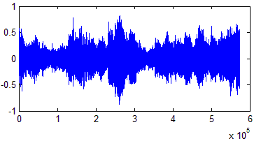
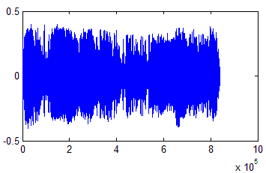
Test Audio sample 1
Test Audio sample 2

Slide 58
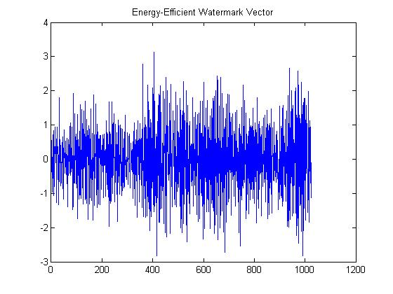
Binary image used as watermark for first level.
A random energy efficient watermark generated during the experiment.

Slide 59
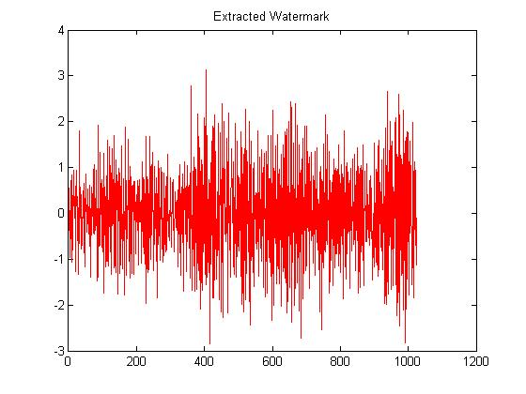
Extracted random watermark.

Slide 60
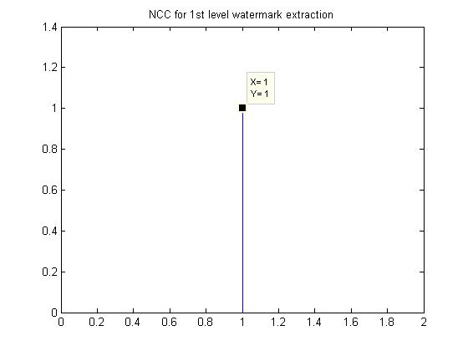
Extracted watermark and NCC of the watermark at 1st level in original Audio

Slide 61
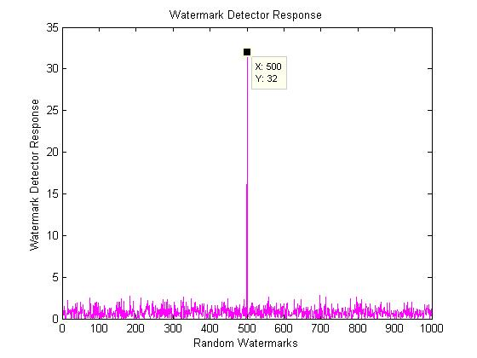
Similarity of 2nd level watermarks in Original Audio

Slide 62
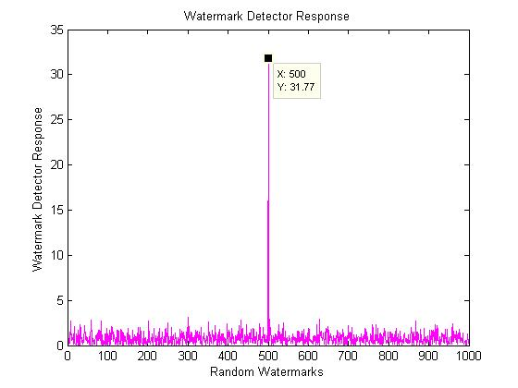
Extracted watermark and NCC of the watermark at 1st level in resampling to 22.05 KHz
Similarity of 2nd level watermarks in sampling to 22.05 KHz.

Slide 63
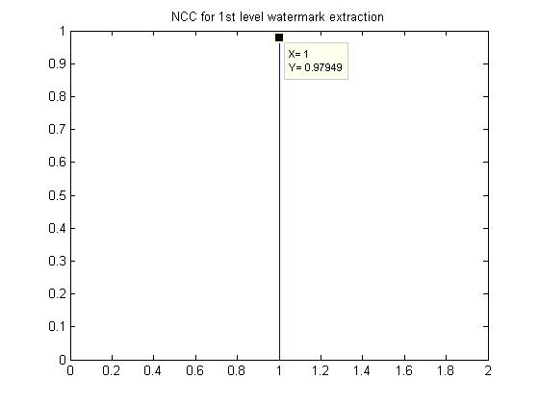
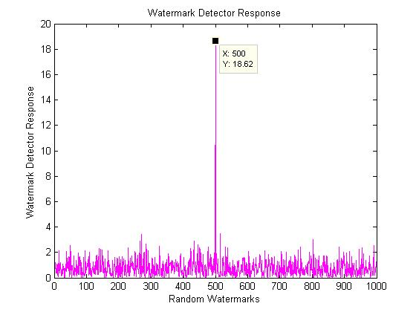
Extracted watermark and NCC of the watermark at 1st level in resampling to 11.025 KHz
Similarity of 2nd level watermarks in sampling to 11.025 KHz

Slide 64
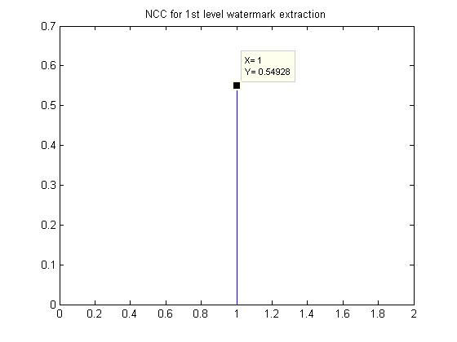
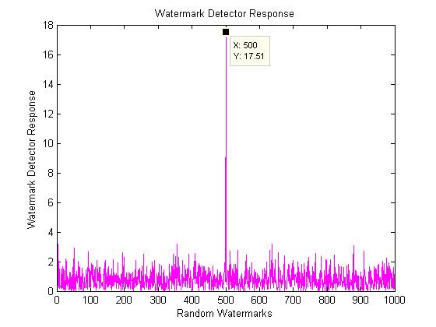
Extracted watermark and NCC of the watermark at 1st level in resampling to 8.82 KHz
Similarity of 2nd level watermarks in sampling to 8.82 KHz.

Slide 65
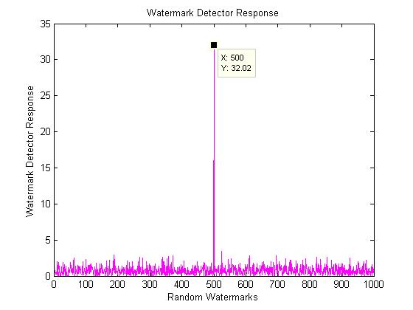
Extracted watermark and NCC of the watermark at 1st level in Requantization to 8 bit
Similarity of 2nd level watermarks in Requantization to 8 bit

Slide 66
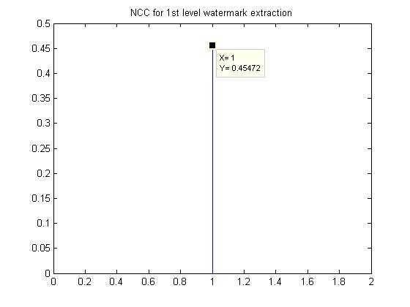
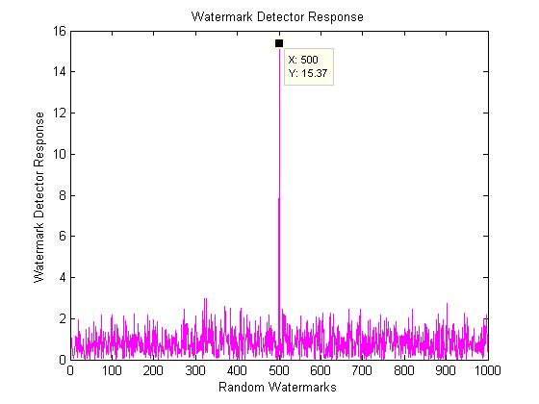
Extracted watermark and NCC of the watermark at 1st level after additive noise
Similarity of 2nd level watermarks after additive noise

Slide 67
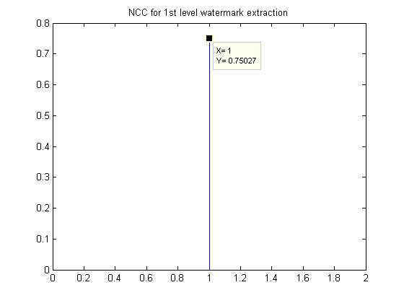
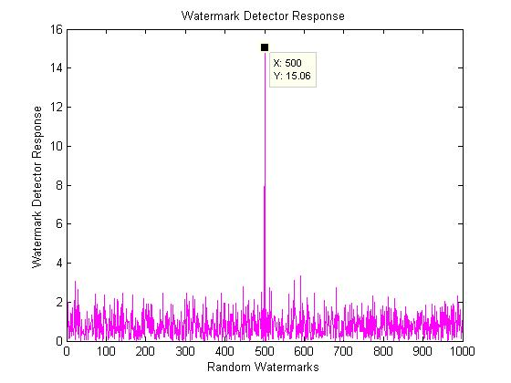
Extracted watermark and NCC of the watermark at 1st level after Mp3 at 128 kb
Similarity of 2nd level watermarks after Mp3 at 128 kb

Slide 68
Extracted watermark and NCC of the watermark at 1st level after Mp3 at 112 kb
Similarity of 2nd level watermarks after Mp3 at 112 kb

Slide 69
Extracted watermark and NCC of the watermark at 1st level after Mp3 at 64 kb
Similarity of 2nd level watermarks after Mp3 at 64 kb

Slide 70
Detectors response for various attacks on sample 1 and sample 2 at first and second level
Attack type | Test sample 1 |  | Test sample 2
 | 1st level of SIM 1 | 2nd level of sim 2 | 1st level of SIM 1 | 2nd level of sim 2
Original watermark | 1.0000 | 32.0089 | 1.0000 | 32.0147
Mp3-128k | 0.7503 | 15.0641 | 0.8935 | 22.4879
Mp3-112k | 0.7503 | 15.0641 | 0.8935 | 22.4879
Mp3-64k | 0.7503 | 15.0641 | 0.8935 | 22.4879
Mp3-48k | 0.7503 | 15.0641 | 0.8935 | 22.4879
Mp3-32k | 0.7503 | 15.0641 | 0.8935 | 22.4879
Additive noise | 0.4547 | 15.3689 | 0.5287 | 14.288
Re-quantization | 1.0000 | 32.0221 | 1.0000 | 32.0147
Re-sampling 22.05 KHz | 1.0000 | 31.7693 | 1.0000 | 31.968
Re-sampling 11.025 KHz | 0.9795 | 18.6173 | 1.0000 | 30.6748
Re-sampling 8 KHz | 0.5493 | 17.5146 | 1.0000 | 29.2121
Cropping | 1.0000 | 5.1765 | 1.0000 | 5.2349

Slide 71
CONCLUSIONS AND FUTURE DIRECTIONS
On the basis of energy efficient watermark and synchronization we proposed a robust audio watermarking scheme. To increase the robustness of synchronization code the proposed algorithm uses Barkers code as synchronization code, embedded in mean value of the several samples of audio and embedding one watermark in DWT-DCT coefficient and generating other energy efficient watermark which is embedded in DWT coefficient. Dual water marking scheme used here make the scheme highly robust as both watermark compensate the drawback of each other. The experimental results have illustrated the robustness and inaudible nature of the audio watermark.

Slide 72
Despite the success of the proposed algorithm for watermarking, it also has draw back. In this method the second level water mark cannot be extracted in cropping attack, so PSC compliant method cannot be used alone to resist cropping attack. Due to dual watermarking technique which may become complex for practical implementation of encoder and decoder also likely to pose problem for real time application Further research will focus on overcoming this problem.

Slide 73
BIBLIOGRAPHY
I. J. Cox and M. L. Miller, “The first 50 years of electronic watermarking,” J. Appl. Signal Process., vol. 56, no. 2, pp. 225–230, 2002.
L. Wei, Y. Yi-Qun, L. Xiao-Qiang, X. Xiang-Yang, and L. Pei-Zhong, “Overview of digital audio watermarking,” J. Commun., vol. 26, no. 2, pp. 100–111, 2005.
L. Wen-Nung and C. Li-Chun, “Robust and high-quality time-domain audio watermarking subject to psycho acoustic masking,” in Proc. IEEE Int. Symp. Circuits Syst., AZ, 2002, vol. 2, pp. 45–48.
D. Megías, J. Herrera-joancomartí, and J. Minguillón, “A robust audio watermarking scheme based on MPEG 1 layer III compression,” in Communications and Multimedia Security—CMS 2003. New York: Springer-Verlag, 2003, vol. 963, LNCS, pp. 226–238.
H. J. Kim, “Audio watermarking techniques,” in Pacific Rim Workshop on Digital Steganography, Kyushu Institute of Technology, Kitakyushu, Japan, Jul. 3–4, 2003.

Slide 74
S. Sheng-He, L. Zhe-Ming, and N. Xia-Mu, Digital Watermarking Technique. Beijing, China: Science, 2004.
D. Kirovski and H. S. Malvar, “Spread spectrumwatermarking of audio signals,” IEEE Trans. Signal Process., vol. 51, no. 4, pp. 1020–1033, Apr. 2003.
H. O. Kim, B. K. Lee, and N. Y. Lee, Wavelet-based audio watermarking techniques: Robustness and fast synchronization [Online]. Available: http://amath.kaist.ac.kr/research/paper/01–11.pdf
W. Yong, H. Ji-Wu, and Y. Q. Shi, “Meaningful watermarking for audio with fast resynchronization,” J. Comput. Res. Develop., vol. 40, no. 20, pp. 215–220, 2003.
J. W. Huang, W. Yong, and Y. Q. Shi, “A blind audio watermarking algorithm with self-synchronization,” in Proc. IEEE Int. Symp. Circuits Syst., AZ, 2002, vol. 3, pp. 627–630.
X.Y.Wang and H.Zhao, “ A Novel Synchronization Invariant Audio Watermarking Scheme Based on DWT and DCT” IEEE Transactions on Signal Processing, vol. 54, no.12, pp.4835-4840, 2006

Slide 75
Su, J.K.; Girod, B., “Power-spectrum condition for energy-efficient watermarking” IEEE Transactions on Multimedia,vol. 4, no. 4, pp. 551-560, 2002
I. J. Cox, J. Kilian, T. Leighton, and T. Shamoon, “Secure spread spectrum watermarking for multimedia,” NEC Res. Inst., Princeton, NJ, Tech. Rep. 95-10, Oct. 1995.
Kamalika Datta, Indranil Sengupta , 2010, “A Redundant Audio Watermarking Technique using Discrete Wavelet Transformation”, Second International Conference on Communication Software and Networks.

Slide 76
THANK YOU!!

